Slide 1

Putting the Amino Acids Together
Protein Structure and Function

Slide 2
Sequencing Proteins

Slide 3
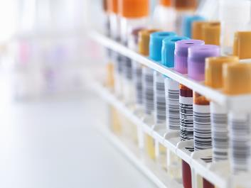
Protein Structure
Primary
Secondary
Tertiary
Quaternary

Slide 4
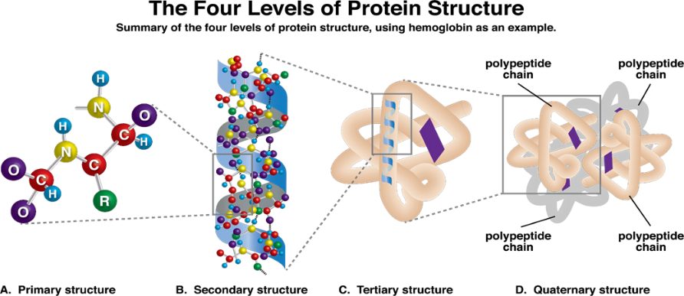
The 4 Levels of Protein Structure
Figure 4.4 The 4 Levels of Protein Structure

Slide 5
Primary Structure
The amino acid sequence
Involves peptide bonds
Restriction enzymes are used to sequence proteins

Slide 6
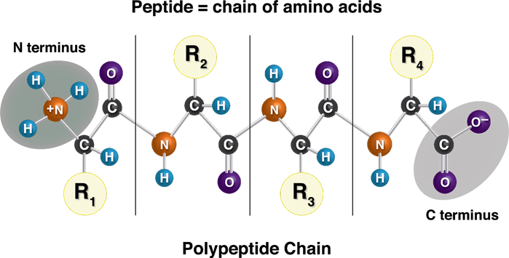
Peptide Bond
Figure 4.1 Primary Amino Acid

Slide 7
Before we understand the present…we need first visit the past!
Sequencing

Slide 8
The History of Sequencing
Acid hydrolysis
Gel electrophoresis
Ninhydrin reaction
Edman’s degradation
Restriction peptidases

Slide 9
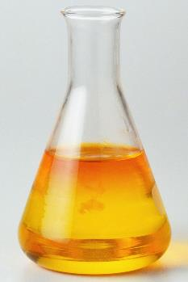
Acid Hydrolysis
Denatures the protein
Does NOT actually sequence the protein
Turns asparagine into aspartate (acidic form) and glutamine into glutamate (acidic form)

Slide 10
Gel Electrophoresis
Uses agarose gel to separate proteins by size first, charge second
Smaller proteins migrate further
Larger proteins stay closer to the start site
Does NOT sequence the proteins

Slide 11
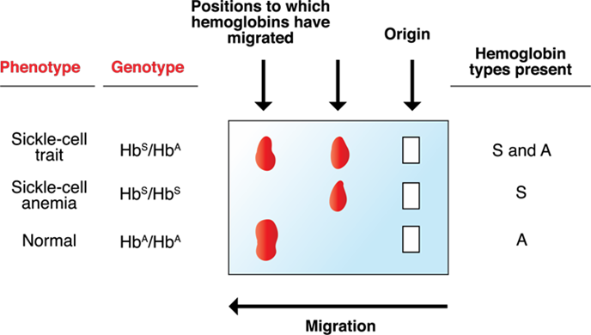
Gel Electrophoresis
Figure 4.2 Gel Electrophoresis

Slide 12
Ninhydrin Reaction
Reacts with all amino acids creating a purple color
Proline reaction creates a yellow color
Good ONLY for counting prolines

Slide 13
Edman’s Degradation
Uses phenyl Isothiocyanate (PITC)
Reacts with ANY amino acid starting on the amino terminal
Amino acids are identified by spectrophotometry (light transmission)
Procedure is accurate ONLY up to 100 amino acids

Slide 14
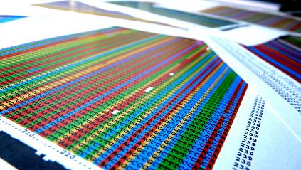
Restriction Peptidases
Restricted by what amino acids they can recognize
Used to sequence proteins

Slide 15
Restriction Peptidases
Trypsin: cuts to the right of LYS and ARG
Chymotrypsin: cuts to the right of the aromatic amino acids, PHE, TRP, TYR
Elastase: cuts to the right of GLY, ALA, SER
CNBr: cuts to the right of MET
Aminopeptidase: cuts to the right of the amino terminal amino acid

Slide 16
Restriction Peptidases, Cont.
Carboxypeptidase: cuts to the left of any amino acid on the carboxyl terminal
Mercaptoethanol: breaks up disulfide bonds

Slide 17
An Example
_ _ _ _ _ _ _
2 3 4 5 6 7
Trypsin ( )( )( )
CNBR ( ) ( )
Elastase
Notes:
Dr. Francis will draw image

Slide 18
Secondary Proteins

Slide 19
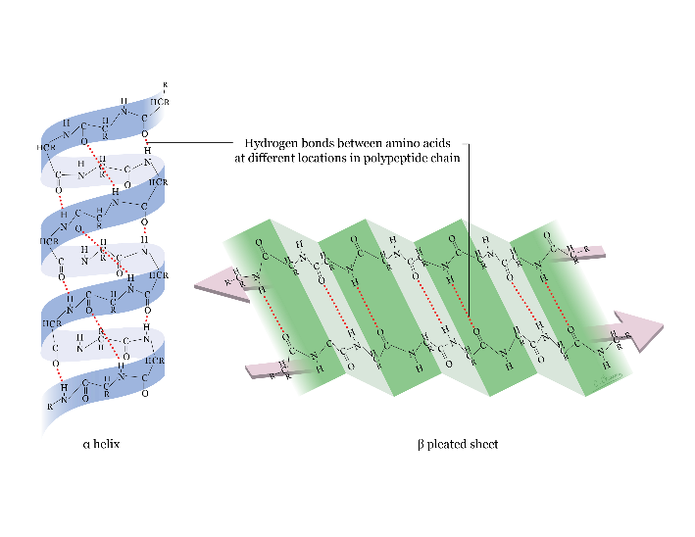
Alpha Helix & Beta Pleated Sheet
Figure 4.3 Alpha Helix & Beta Pleated Sheet

Slide 20
Serum Proteins
Functional
Acute phase reactants

Slide 21
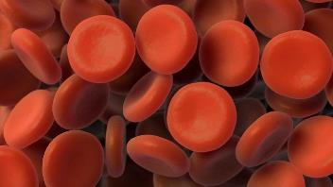
Too Many Proteins in Your Plasma
Elevated ESR or CRP
  Indicates nonspecific inflammation
Falsely high ESR: anemia
Falsely low ESR: sickle cell anemia; polycythemia
Acute phase reactants caused by IL-6

Slide 22
Newer Protein Markers
Procalcitonin
Calprotectin

Slide 23
TOO many acute phase proteins leads to…
Amyloidosis

Slide 24
Amyloidosis
Primary: autosomal dominant
Massive intracerebral hemorrhage in a young person with no prior h/o HTN
Secondary: due to any chronic inflammatory disease
Congo red stain
Apple green birefringence

Slide 25
Secondary Amyloidosis
AA: Chronic Inflammatory Disease
AB: Alzheimer’s Disease
AB-2: Chronic Renal Failure
AE and AF: MEN-II
AL: Multiple Myeloma

Slide 26
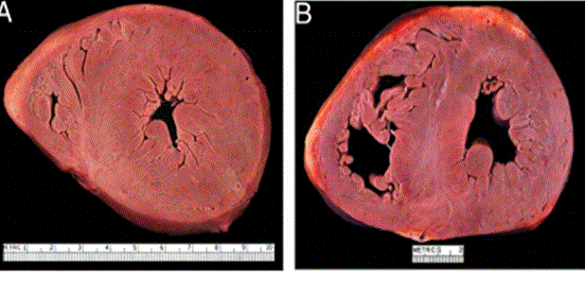
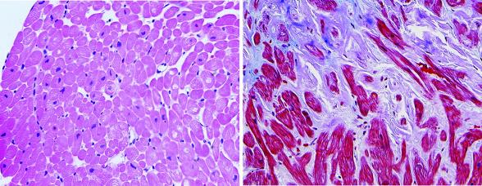
Amyloidosis
Multiple Myeloma-Heart

Slide 27
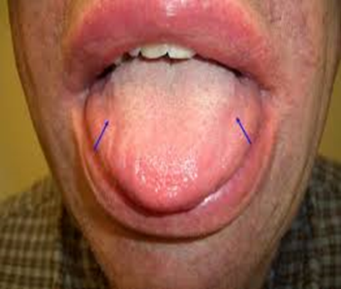
Amyloidosis
Multiple Myeloma

Slide 28
Tertiary Structure
3-D structure
Most important factor is hydrophobic and hydrophilic interactions
Covalent bonds now form

Slide 29
Quaternary Structure
Two or more proteins are interacting
Cooperativity
Allosterism: refers to enzymes
  Allosteric enzyme means the slowest enzyme; means rate-limiting enzyme; means the kinetic curve is sigmoidally shaped

Slide 30
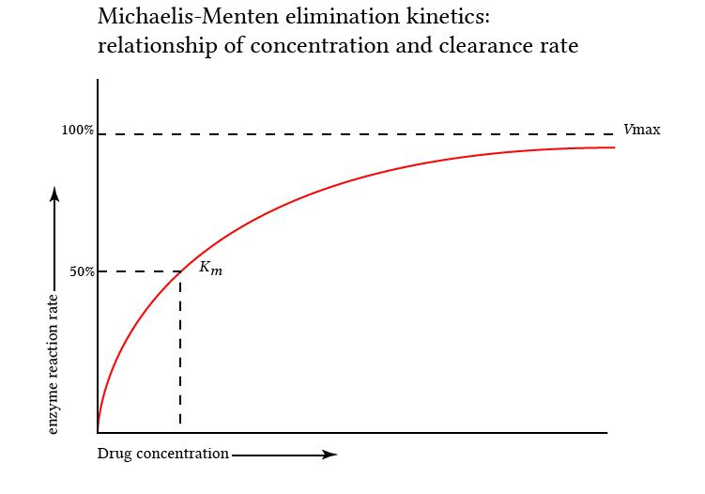
Enzyme Kinetics

Slide 31
Apply Biochemistry to Biostats
Number needed to treat: NNT
  1/Absolute Risk Reduction
Number needed to harm: NNH
  1/Absolute Risk Increase

Slide 32
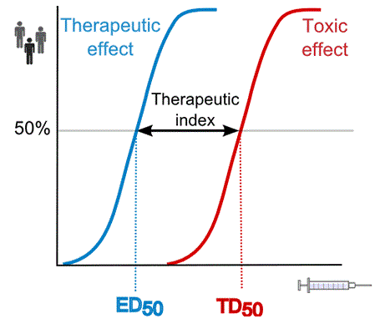
Therapeutic Index (Window)
Therapeutic Dose /Toxic Dose

Slide 33
Am I Within the Narrow Window?
Check the blood levels

Slide 34
For Water Soluble Compounds
Check Peak / Trough levels
Peak: Corresponds to dose(Amount)
Trough: Corresponds to frequency

Slide 35
For Fat Soluble Compounds
Small Ones: Add Sulphur, Nitrogen or Oxygen
Large Ones: Acetylation
  Phosphorylation
  Sulphation
  Adenylation
  Glucuronidation

Slide 36
Zero Order?
Phenytoin
Aspirin
Alcohol

Slide 37
Want More Time in First Order?
Build Tolerance
  Cross-Tolerance
  Dependence
  Addiction
  Abuse

Slide 38
Hemoglobin

Slide 39
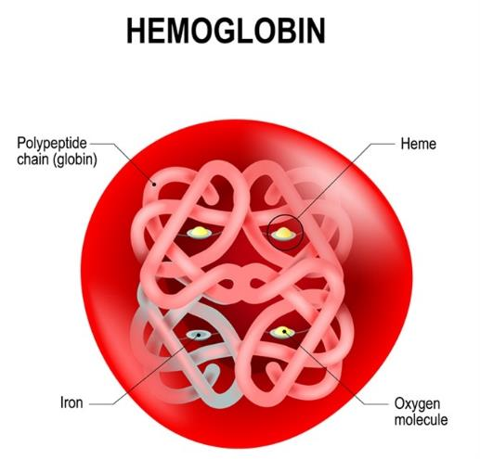
Hemoglobin
The first quaternary protein discovered!

Slide 40
Hemoglobin
Type A: 2 alpha – 2 beta chains
Type A-2: 2 alpha – 2 delta chains
Type F: 2 alpha – 2 gamma chains

Slide 41
Hemoglobin F
Found in the fetus
Disappears by 6 months of age
Has a low affinity for 2,3, DPG
Has a high affinity for oxygen

Slide 42
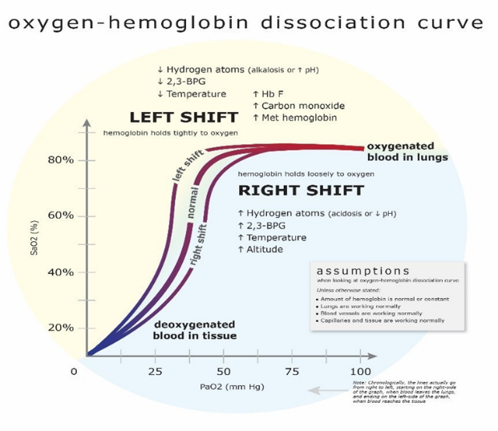
Oxygen Saturation Dissociation Curve
Figure 4.9 Hemoglobin-Oxygen Dissociation

Slide 43
You Should Know
Oxygen Content = Hemoglobin + PO2
PO2: 80 (60 -100)
PCO2: 40 (35 – 45)
pH: 7.40 (7.35 -7.45)
HCO3: 24 (22 -26)
ABG: checks how much Oxygen is dissolved in blood
SAo2: checks what percentage of sights (on hemoglobin) are bound (Pulse Oximetry)

Slide 44
Shifts Curve to the Right
Decreased oxygen
Increased H+ (protons)
Increased 2,3-DPG
Increased pCO2
Increased exercise
Increased altitude
Increased temperature
Decreased pH

Slide 45
PO2 from 40 to 60
Hypoxic Period: Acidosis builds up
  Denature Proteins
  Cause Hyperkalemia
  Kussmaul breathing
  Increased GABA

Slide 46
Adapting to Chronic Hypoxia
Increased Erythropoietin
Increased mitochondrial density
Increased angiogenesis

Slide 47
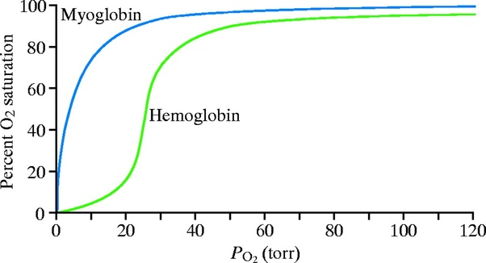
Myoglobin and Hemoglobin F

Slide 48
Principles
The Second Wind of Exercise
No Pain, No Gain!

Slide 49
Muscle Break Down
Myositis Elevated CPK
Polymyositis
Dermatomyositis
Rhabdomyolysis Elevated Myoglobin

Slide 50
Differential
Most common: Hypothyroidism
Second Endocrine Disease Cushing’s Syndrome
Second most Common: Drugs
Statins
Autoimmune: Jo-1 (tRNA synthetase)
Parasitic: Trichinella Spiralis
Taenia Solium

Slide 51
Dermatomyositis
A Paraneoplastic Syndrome
Heliotropic Rash (Gottron’s Sign)
Associated with internal malignancy: Colon Cancer

Slide 52
Rhabdomyolysis
Most Common Cause: Crush Injuries
Second most common: Drugs
Statins
Diagnosis: Red Urine, no RB
Muddy Brown Casts
Treatment: Fluids; Bicarb

Slide 53
Acute Tubular Necrosis
Damage to the Proximal Convoluted Tubule
Muddy Brown Casts
Can Be Toxic or Ischemic

Slide 54
Erythropoiesis
Begins: in yolk sac at 4 months gestation
6 mo. gestation: moves into the liver, spleen, and flat bones
8 mo. gestation: moves into the long bones
1 year of age: liver, spleen, and flat bones close
If you lose the long bones after 1 year, the spleen can reopen causing massive splenomegaly

Slide 55
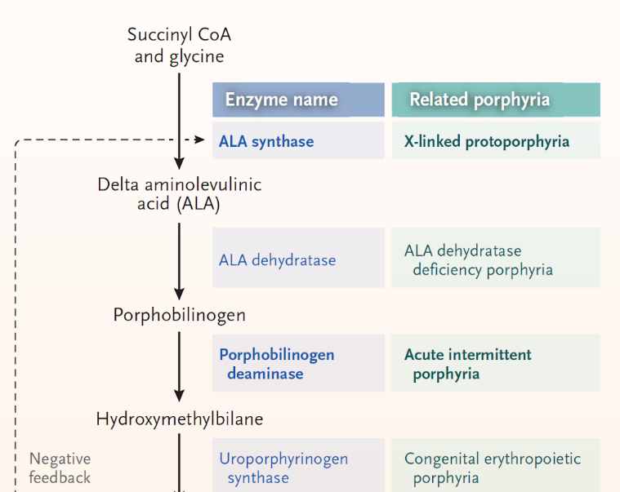
Heme Synthesis Part 1

Slide 56
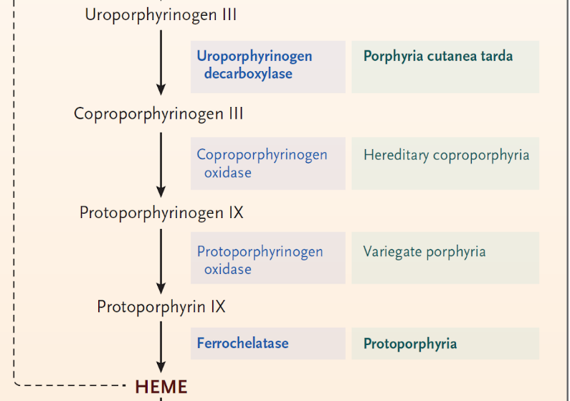
Heme Synthesis Part 2

Slide 57
What You Should Know About Every Pathway
The End Product
The Rate Limiting Enzyme
  Allosteric Activator
  Allosteric Inhibitor
The Substrate that begins the pathway

Slide 58
What You Should Know About Every Pathway
The End Product
The Rate Limiting Enzyme
  Allosteric Activator
  Allosteric Inhibitor
The Substrate that begins the pathway

Slide 59
Anabolic Vs Catabolic
Anabolic: goes on in the cytoplasm
Catabolic: goes on in the mitochondria
  Except glycolysis
Both compartments: Heme synthesis, Urea cycle, gluconeogenesis, FA synthesis, Nucleotide synthesis

Slide 60
What you need to make Heme
Glycine
Pyridoxine
Porphyrin rings
Heme (add iron)

Slide 61
Methemoglobinemia
Iron is oxidized and unable to pick up oxygen
  PO2 normal
  Saturation (SAO2) low
Treatment: Methylene Blue

Slide 62
Causes of Methemoglobinemia
Infection
Drugs: Sulfa drugs, antimalarials, metronidazole, isoniazid

Slide 63
Cyanide Poisoning
PO2 normal
SAO2 low
Most common causes: sodium nitroprusside
Treatment:
  Amyl Nitrite
  Vitamin B-12
  Methylene Blue
  Transfusion

Slide 64
Microcytic Hypochromic Anemias
Iron Deficiency Anemia
Anemia of Chronic Disease
Lead Poisoning
Thalassemias
Hemoglobinopathy (S and C disease)
Sideroblastic Anemia

Slide 65
Iron Deficiency Anemia
Most common cause of microcytic hypochromic anemia
In children: Mcc is inadequate intake
In young adults: Mcc is still inadequate intake
20 to 40: IBD
> age 40: mucosal bleeding
Tx: ferrous sulphate
Labs: decreased serum iron, ferritin, Hg saturation
Increased TIBC

Slide 66
Anemia of Chronic Disease
Begins 3 weeks after an illness
Three Mechanisms:
  Decreased production
  Increased destruction
  Hepcidin (an acute phase reactant) interferes with transferrin’s ability to bind iron (blocks absorption)
  Labs: decreased serum iron and Hg saturation; increased ferritin and TIBC

Slide 67
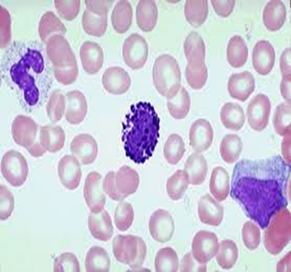
Lead Poisoning
Lead inhibits delta ALA dehydrase as well as ferrochelatase
Mcc: eating peeling paint from old buildings
Classic clue: basophilic stippling; elevated FEP (free erythrocyte protoporphyrins)

Slide 68
Lead Levels to Know
First screen at one year of age
Heel sticks versus venous levels
  0 – 5: follow levels every 6 mo.; get good history
  If 5 – 14: get even more history; follow levels every 3 mo.
  If 15 – 44: get health department involved; follow lead levels monthly
  If 45 – 69: treat with oral succimer; follow levels monthly
  If 70 or above: use one drug if no neuro sx; use 2 drugs if neuro sx
Drugs are
  EDTA
  Dimercaprol
  Penicillamine

Slide 69
Drug Induced Lupus
Anti-histone antibodies
Hydralazine
INH
Procainamide
Penicillamine
Phenytoin
Ethosuximide

Slide 70
Lead used to be the most common cause of mental retardation of mental retardation.
But NOT ANYMORE!

Slide 71
Mental Retardation
Fetal alcohol syndrome
Fragile X syndrome
Down’s syndrome

Slide 72
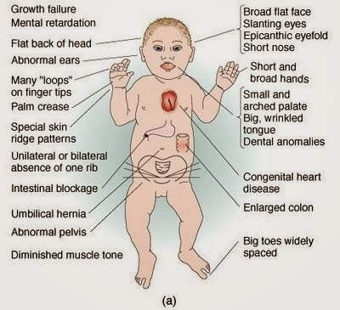
Mental Retardation

Slide 73
Porphyrias
A group of enzyme deficiencies
Synthesize too many porphyrin rings or inadequate metabolism are the problems
Porphyrin rings in the urine make it red
Two types are most important…

Slide 74
Acute Intermittent Porphyria
Enzyme deficiency
A build up of porphyrin rings
Porphyrin rings are deposited in visceral organs and around nerves
Recurrent severe abdominal pain and neuropathy
Tx:

Slide 75
Managing Abdominal Pain
NPO
IV Normal Saline
Nasogastric Tube
Meperidine for pain
ABD Xray
CT scan (if still unsure)

Slide 76
Managing AIP
As for abdominal pain
Increased sugar in fluids (D10 vs D5)
Hematin

Slide 77
Burns
First degree: involves only epidermis
  Redness is seen
  NO extra fluids needed
Second degree: involves epidermis, under the epidermis
  Blisters visible
  Extra fluid resuscitation required
Third degree: involves epidermis and dermis
  Neuropathy on exam
  Extra fluid resuscitation required

Slide 78
Parkland Formula
Calculates deficit ONLY
(4cc Normal saline)(WT in Kgs)(% burned skin)
Give HALF of deficit plus maintenance over the first 8 hours
Give second HALF of deficit plus maintenance over the next 16 hours
EVERY patient should be fully hydrated by 24 hours

Slide 79
Rule of Nines
Head N Neck: 9%
Each arm: 9% each
Torso: front 18%, back 18%
Each leg: 18% each
Genitals: 1%
For children: Head 27%
  Arms and legs: 9% each
  Torso: front 18%, back 18%
  Genitals: 1%

Slide 80
A Lesson in Fluid Management

Slide 81
Children
Maintenance fluid: ¼ normal saline
Mild dehydration: ½ normal saline
Moderate or severe dehydration: 0.9 normal saline

Slide 82
Calculating Maintenance Fluids for Children
First 10Kg: 100cc/Kg
Next 10Kg: 50cc/Kg
After 20Kg: 20cc/Kg
Calculate total/24 hours = hourly rate

Slide 83
Adult Fluids
Maintenance: ½ normal saline
ANY dehydration: 0.9 normal saline
Rate: 1.5cc/Kg/hour

Slide 84
Which Fluid?
Normal Saline
  154Meq NACL/L
  14Meq too much NACL
  Too much chloride forces kidney to waste bicarbonate
  Great for metabolic alkalosis
Ringers Lactate
  130Meq NACL/L
  10Meq too little NACL
  Contains bicarbonate
  Great for metabolic acidosis

Slide 85
When to use 3% Saline
Hyponatremia, with sodium under 120, and with symptoms
Increased intracranial pressure
As an aerosol for obstructive lung disease

Slide 86
Erythrocytic Protoporphyria and Porphyria Cutanea Tarda
Enzyme deficiency
Porphyrin rings are deposited underneath the skin
Light reacts with the rings causing a release of heat which leads to burns
Mcc of death: skin infections
Tx: protect them from light
  Get blue or red light
  Give Vit D and Calcium

Slide 87
Pharmacokinetics
CNS Depressants and Analgesic

Slide 88
Opiates
CNS depressants
Muscle relaxants
Analgesics
Receptors:
  Mu (CNS)
  Kappa: Spinal cord
Clue: Pinpoint pupils
Withdrawal clue: severe
  cramps, urination

Slide 89
Create a Pattern!

Slide 90
Benzodiazepines
Increase frequency of chloride channel opening
Flurazepam
Alprazolam
Triazolam
Temazepam
Oxazepam
Clonazepam
Diazepam
Lorazepam
Midazolam
Chlordiazepoxide
Flumazenil
Notes:
Add slides for benzos, barbs, alcohol and misc. CNS comes last

Slide 91
Barbiturates
Increase duration of chloride channel opening
Primidone
Phenobarbital
Thiopental
Amobarbital
Secobarbital
Overdose
Fluids
Bicarb
Doxapram
Notes:
Add slides for benzos, barbs, alcohol and misc. CNS comes last

Slide 92
Alcohol
Benzos, Barbs and alcohol and opiates all have the same pattern: CNS depressants = will slow you down.
  MCC of death while toxic is respiratory failure.
Withdrawal of these drugs will cause things to speed up.
  MCC of death during withdrawal is arrhythmias
Alcohol withdrawal leads to formication (sensation of insects crawling underneath the skin)
Notes:
Add slides for benzos, barbs, alcohol and misc. CNS comes last

Slide 93
Miscellaneous
Zolpidem
Eszopiclone
Topiramate
Propofol
Gabapentin
Pregabalin

Slide 94
Opiates
Heroin
Methadone
Morphine
Meperidine
Codone
Oxycodone
Codeine
Dextromethorphan
Loperamide
Diphenoxylate
Fentanyl
Pentazocine
Buprenorphine
Apomorphine

Slide 95
Opiate Overdose
Naloxone
Naltrexone
Methylnaltrexone (OIC)

Slide 96
Hemoglobinopathies
Hemoglobin S disease
Hemoglobin C disease

Slide 97
Hemoglobin S Disease
Autosomal recessive
High prevalence in Africa (natural selection)
Substitution of valine for glutamate at position 6 of beta chain
Hypoxia causes cells to sickle leading to vaso-occlusion

Slide 98
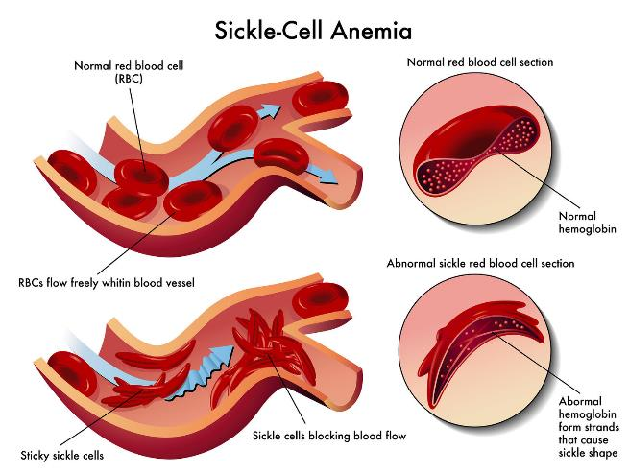
Sickle Cell

Slide 99
Vaso-occlusive Crises
CVA
Pulmonary Infarction
Splenic Sequestration
Priapism
  Tx: exchange transfusion; oxygen

Slide 100
Aplastic Crisis
Complete bone marrow suppression
Always check the reticulocyte count
Mcc: parvovirus B-19

Slide 101
A Few Points to Remember…
Functional asplenia by age 6 due to infarcts
  Susceptible to encapsulated organisms
  Give pneumovax anytime after age 2
Infections are mcc reason for crises
Hydroxyurea increases HgF, decreasing chance for hypoxia
Use opiates for pain
Transfuse when anemic and symptomatic

Slide 102
Functions of the Spleen
Removes old RBCs
  Spherocytes
Removes damaged RBCs
Removes nuclear remnants
  Howell-Jolly Bodies
Removes encapsulated organisms
Erythropoiesis if bone marrow shuts down

Slide 103
Sickle Cell Trait
Careers to avoid: firemen, pilots, deep sea diving
How they present to physician: Hematuria

Slide 104
Hemoglobin C Disease
Autosomal recessive
Substitution of LYS for GLU at position 6 of beta chain
NO sickling occurs since both amino acids are hydrophilic

Slide 105
Thalassemias
Represent gene deletions
Autosomal recessive
Common in Mediterranean people
Minor: at least one gene remaining
Major: no genes remaining

Slide 106
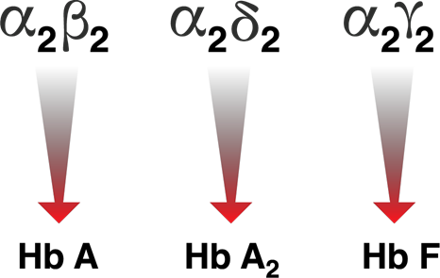
Hemoglobins
Figure 4.9 Hemoglobins (HbA, HbA2, HbF)

Slide 107
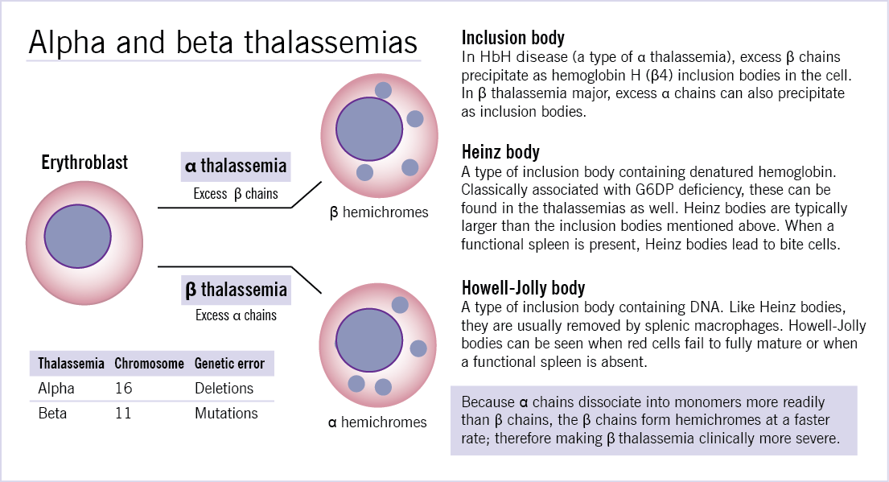
Alpha Thalassemia

Slide 108
Baseline Labs
RBC Mass: 3.5 to 4.5 million
Hemoglobin/Hematocrit: 15/45%

Slide 109
Alpha Minor
One gene missing
  Asymptomatic – (HG 12) 75%
Two genes missing
  IF sedentary: asymptomatic
  IF active: symptomatic - (HG 7.5) 50%
Three genes missing
  Symptomatic in ALL - (HG 4 to 5)

Slide 110
Alpha Thalassemia Major
NO genes remaining
Unable to make any hemoglobin at all
Hydrops Fetalis
Hemoglobin Bart (4 gamma chains)
Hemoglobin H (4 beta chains)

Slide 111
Beta Thalassemia: 2 genes
Beta minor (Hg 7.5)
  One gene missing
  If sedentary: asymptomatic
  If active: symptomatic
  Increased Hg A-2 and Hg F
  Ineffective erythropoiesis
Beta major
  Both genes missing
  Able to make only Hg A-2 and Hg F
  Asymptomatic until 6 months of age
  Transfusion dependent

Slide 112
Blood Transfusions
Done ONLY when patient is symptomatic
CHF: Keep Hg 10 to 12
Renal Failure: keep Hg 10 to 12
One unit of PRBCs
  Raises Hg by 1 to 2 grams (3 to 6 HCT)
  Delivers 3.4 grams of iron

Slide 113
Transfusion Products
Whole Blood
Fresh Frozen Plasma (FFP)
Packed Red Blood Cells (PRBCs)
Cryoprecipitate
Platelets
DDAVP
Factor VIII Concentrate
5% Albumin
25% Albumin

Slide 114
Who Needs Albumin?
Kwashiorkor Isotonic: 5% albumin
Cirrhosis
Nephrotic Syndrome
Celiac Sprue
Menetrier Disease
CHF Hypertonic: 25% albumin
RF

Slide 115
Transfusion Products
Immunoglobulins
  Passive Immunity
  Blocking Antibodies
  Hypo/Agammaglobulinemic Patients

Slide 116
Transfusion Related Reactions
Anaphylaxis
  Selective IG-A Deficiency
Acute Febrile Reaction
  White Cell Antigens
ABO Incompatibility
  Most common
  Stop transfusion
  Re-type and cross
TRALI: transfusion related acute lung injury
TACO: transfusion associated circulatory overload
TRU : Transfusion Related Urticaria

Slide 117
Iron Overload
Hemosiderosis: bone marrow is overwhelmed by iron
Hemochromatosis: iron overload has involved other organs
  Skin: bronze pigmentation
  Liver: bronze cirrhosis
  Pancreas: bronze diabetes
  Heart: restrictive cardiomyopathy

Slide 118
Hemochromatosis
Primary
  Autosomal recessive
  Too much iron absorption from duodenum
  HLA A3 on chromosome 6
Secondary
  Too many transfusions
  Mcc of death in first 10 years: transfusion related infections
  Mcc of death after 10 years: CHF

Slide 119
Prussian Blue
Stain for Iron

Slide 120
Deferoxamine
Iron Chelator

Slide 121
Transfusion Related Infections
HIV infections
Hepatitis B
Hepatitis C
Hepatitis D
EBV
CMV
Hemorrhagic viruses
Bacterial infections
  Malaria
  Babesiosis
  Syphilis

Slide 122

Hemoglobin Saturation Curve
Figure 4.9 Hemoglobin-Oxygen Dissociation

Slide 123
Collagen

Slide 124
More than a quaternary structure…
It’s a TRIPLE HELIX

Slide 125
4 Types of Collagen
Type 1: Skin
Type 2: Connective tissue
Type 3: Arteries
Type 4: Basement membrane

Slide 126
To Synthesize Collagen
Glycine: every third amino acid
Lysine
Proline
OH-Proline
OH-Lysine
Notes:
Dr Francis needs to draw the note

Slide 127
What else do I need?
Vitamin C: Needed to hydroxylate lysine and proline
Copper: Needed to hydroxylate lysine
Homocysteine: blocks lysine hydroxylase

Slide 128
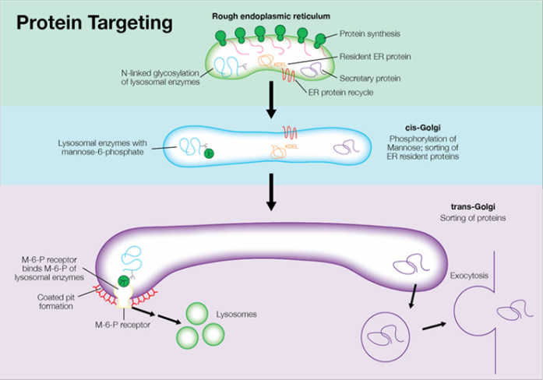
Protein Synthesis for Packaging…
Figure 4.11 Collagen Synthesis

Slide 129
Protein Labels
Pre-sequence
Pro-sequence
Mannose 6 Phosphate Label
Short Amino Terminal Sequence

Slide 130
Pre-Sequence
Guides a protein INTO the rough endoplasmic reticulum

Slide 131
Pro-Sequence
Guides a protein to the Golgi apparatus
Chaperone: HSP- 90

Slide 132
Pro-Insulin
The ONLY protein for whom the pro-sequence is NOT destroyed
It is cleaved off but is packaged with the insulin and released

Slide 133
C Peptide
High C peptide and high insulin
  Nesidioblastosis
  Insulinoma
  Sulfonylureas
Low C peptide and high insulin
  Factitious

Slide 134
Sulfonylureas
Chlorpropamide
Tolbutamide
Tolezelide
Glyburide
Glipizide
Glimepiride

Slide 135
Sulphur Connection
Anaphylaxis
Urticaria
Erythema Multiforme
Stevens Johnson Syndrome
Toxic Epidermal Necrolysis (TEN)
Nonspecific rash
Methemoglobinemia
Hemolytic anemia
Disulfiram reaction
Acute renal failure
Acute tubular necrosis
Interstitial nephritis
Kidney stones
Drug induced lupus
Photosensitivity
Most protein bound drug
Leukocytoclastic
Kernicterus

Slide 136
Mannose 6 phosphate
Guides a protein from the Golgi apparatus to the lysosomes

Slide 137
I–Cell Disease
Empty lysosomes
Acid hydrolases in the plasma

Slide 138
Short Amino-Terminal Sequence
Guides a protein from the RER to the mitochondria
Chaperone: HSP- 70

Slide 139
Mitochondrial Genetics
Chromosomes are CIRCULAR
Transmitted ONLY through mothers
Muscle biopsy: ragged or wavy red fibers
Heteroplasmy: variable expression

Slide 140
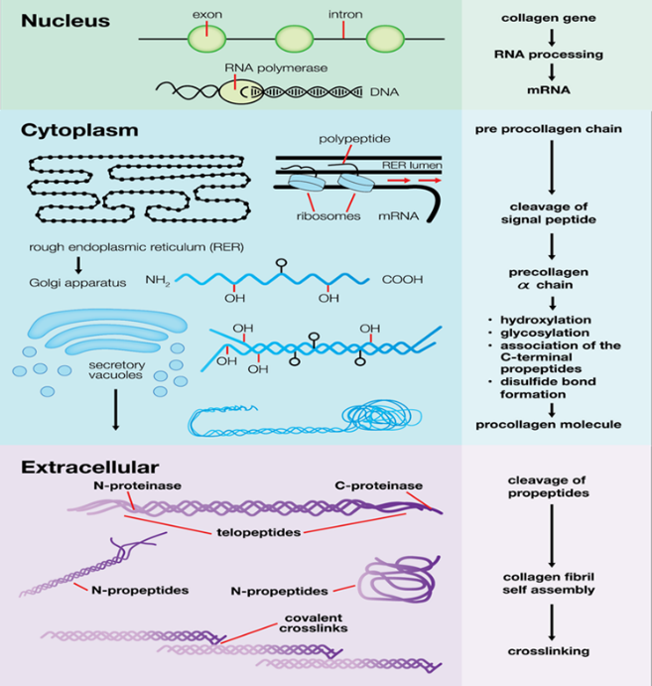
Figure 4.12 Collagen Synthesis Cont.

Slide 141
ALL Modification of collagen done in RER

Slide 142
Who Makes Collagen?
Fibroblasts: simple scarring
Myofibroblasts: if you need wound contraction

Slide 143
Fibroblasts
Show up to inflammation: at 7 days
Peak: 1 month
Complete scarring: 6 months

Slide 144
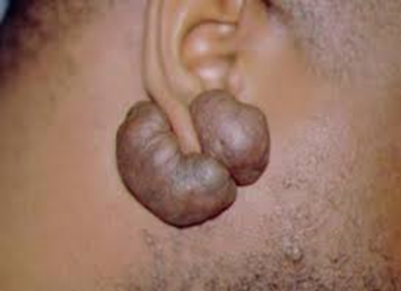
When Collagen Synthesis Goes Wrong…
Desmoplasia
  Collagenous reaction surrounding a tumor
Keloid
  Too much collagen deposition

Slide 145
COLLAGEN PROFILE
All you need now is a clue…

Slide 146
Collagen
S Skin
C Connective tissue
A Arteries
B Basement Membrane

Slide 147
Anytime You Can Connect To The Low Energy State…
Apply the entire concept this accounts for approximately 98% of illnesses
Whenever in doubt > assume it is a low energy state
Stop Guessing!!!

Slide 148
Collagen Diseases
Ehlers Danlos
Marfan’s
Homocystinuria
Scurvy
Osteogenesis imperfecta
Minke’s kinky hair syndrome

Slide 149
Pleiotropy
A minor mutation with devastating consequences:
Osteogenesis Imperfecta
Homocystinuria

Slide 150
Secondary Collagen Diseases
Ankylosing spondylitis
Fragile X syndrome
Syphilis
Takayasu’s disease

Slide 151
HLA B-27 Diseases
Sacroiliitis and lumbosacral inflammation
Ankylosing Spondylitis
Psoriasis
Reactive Arthritis

Slide 152
Collagen Vascular Diseases
CREST
Scleroderma
Progressive systemic sclerosis
Rheumatoid arthritis
  Felty’s syndrome
  Bechet's syndrome
  Sjogren's syndrome
SLE
MCTD

Slide 153
TNF Drugs
Etanercept
Infliximab
Adalimumab
Golimumab
Certolizumab

Slide 154
Other Quaternary Proteins

Slide 155
Elastin
Has many GLYCINES
Has PROLINES
Has LYSINES
Has OH-PROLINES
NO hydroxylysines

Slide 156
Elastin
Provides COMPLIANCE
Provides ELASTICITY
Has DESMOSINE

Slide 157
Elastase
Destroys elastin
Cuts to the right of GLY, ALA, and SER
Alpha-one antitrypsin inhibits elastase
Found in neutrophils and bacteria
Smoke inhibits alpha-one antitrypsin
Decreased alpha-one antitrypsin with aging

Slide 158
Emphysema
Destruction of elastin
Loss of recoil
Panacinar: alpha-one antitrypsin deficiency
Centroacinar: smoking
Disto-acinar: aging
Bullous: staph aureus and pseudomonas

Slide 159
Who’s afraid of Staph Aureus and Pseudomonas?
Neutropenic
Burn patients
Cystic fibrosis
Diabetics
If any fever, cover staph aureus with one antibiotic and cover pseudomonas with two antibiotics

Slide 160
Keratin
Made for tensile strength
Contains a lot of CYSTEINES

Slide 161
The End
For now…

